Slide 3


Alfredo Jiménez Martín
MICROSOFT
Services Consultant
Enterprise Communication Global Practice

Slide 4

José Carlos García Graña
MICROSOFT
Services Architect
Enterprise Communication Global Practice

Slide 5
Skype for Business: Step forward in Universal Communications

Slide 6
Agenda
Skype for Business User Interface
Deep dive in Skype Directory Search
Phone Features
Deep dive in Call Via Work
Videoconference Integration
Dee dive in Video Interoperability Server (VIS)
Hybrid Features
Deep dive in Broadcast Meetings
Upgrade to Skype for Business

Slide 7
User Interface

Slide 8

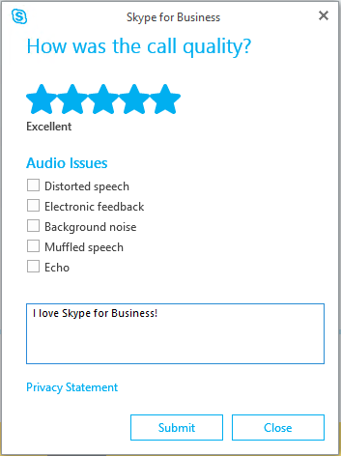
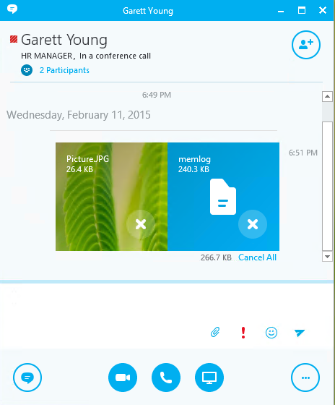
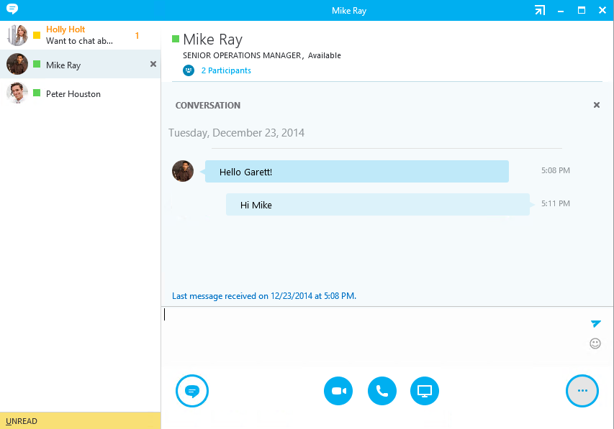
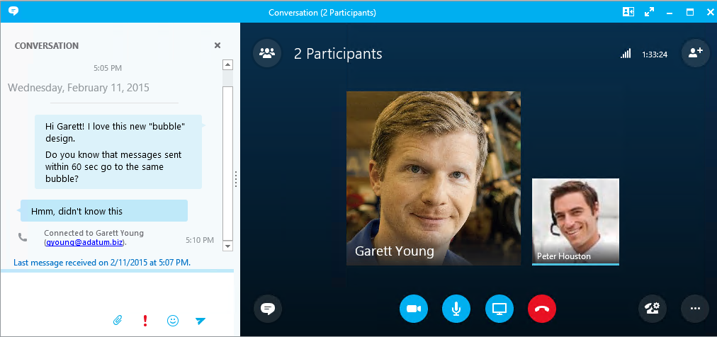

Client internals
Messages combined in one bubble if sent within 60 sec
Message preview in tab view
New File transfer experience
Call Monitor in audio and video
Rate My Call

Slide 9
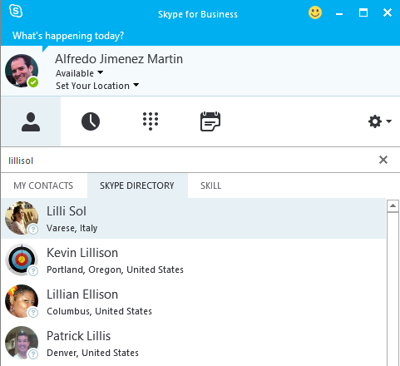
Skype (Consumer) Directory Search
Search by
Display name John Doe
Display name + location – Ex: John Doe in Spain
Email – Ex: johndoe@outlook.com
Phone – Ex: 123-456-7890
Skype ID – Ex: JohnDoe1456

Slide 10


Online Services
Skype Graph
Service
Lync
Federation Edge
Skype for Business – Skype Connectivity Gateway
Skype Contact Store
Edge
Skype Chat Federation Gateway
Skype Chat Service
Skype Client
Skype for Business Pool
Skype for Business Online
On-Premises
User
On-Line
User

Slide 11
Supported Deployment matrix for Skype Directory Search
 | Skype for Business Server 2015 Front End | Lync Server 2013 (or older) Front End | Comments
Skype for Business Server 2015 Edge | Supported | Not Supported | Skype for Business Server 2015 and Edge are prerequisites for Skype Directory Search
Skype for Business Server 2015 Edge + Lync Server 2013 Edge deployed side-by-side | Supported | Not Supported | Skype Directory Search traffic flows through Skype for Business Server Edge servers. Federation traffic goes through edge configured by the administrator. For example, the administrator could choose to continue to send federation traffic through Lync Server 2013 Edge servers which would not support Skype Directory Search.
Lync Server 2013 (or older) Edge | Not Supported | Not Supported

Slide 12
Deployment & Configuration
Uses Skype for Business Server federation access architecture
Microsoft PIC set up needed (http://pic.lync.com)
Provisioning Guide for Skype for Business-Skype Connectivity
Skype Search and SkypeID routing requires Enterprises already enabled for Skype federation to upgrade to Skype for Business.
Networking flow: Client to the Pool (TCP 443 – same as ABWQ) The Pool to the Edge (TCP 4443 – same as CMS replication) Edge to Skype Directory Search in Azure (TCP 443 - Access Edge Interface)

Slide 13
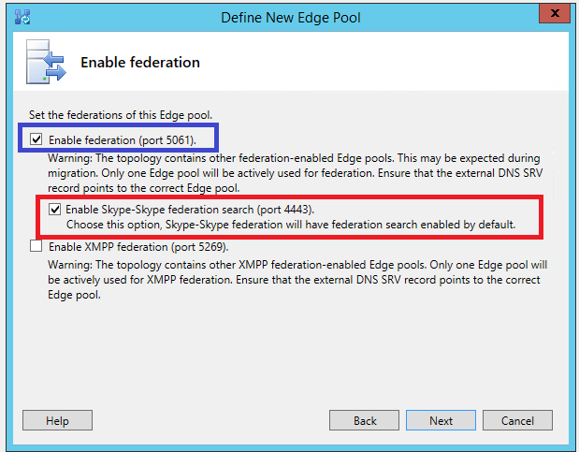
Topology Configuration

Slide 14
Phone Features

Slide 15
Phone Features in Skype for Business
Incoming and Outgoing Calls
Dial Plan and Normalization Rules
Voice Routes
Voice Policies
Dial In Conferencing
PSTN User dials the conference access number followed by the conference Id
Available for Enterprise Voice and non-Enterprise Voice users
Conference dial-out for non-EV users
New conference policy setting allows authenticated-but-non-enterprise-voice users to dial out using the organizer’s policy.
Anonymous participants have always used the organizer’s policy.
Location-based routing
Routes the call based on location of the caller
Scoped to specific locations, gateways and users
Uses existing Lync networks sites/subnets
Remote Call Control not supported anymore → Replaced with Call Via Work

Slide 16
Call via Work
Enterprise Voice for PBX Users
Skype for Business users can make voice calls using any PSTN phone, including existing PBX endpoints
Leverages existing Direct SIP connectivity between PBX systems and Lync/Skype for Business
User experience
Skype for Business dials out to PSTN or desk phone number to connect user, then connects with far-end destination
Features
Presence update and call control from Skype for Business client
Mid-call control capabilities preserved on PBX phone
Inbound
Simultaneous Ringing is tied with activation of Call via Work feature
Call via Work doesn’t have an inbound experience
Infrastructure
Should operate with any supported PSTN egress
May find complexity with numbering support
Cloud
Not available in Skype for Business Online

Slide 17
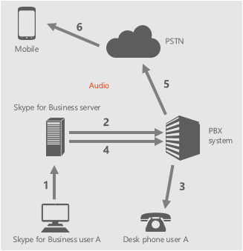
Outbound call to external user (PSTN)
User A initiates a call to PSTN
UCWA places the initial call to self/desk phone
PBX rings the desk phone of user A
Once answered, UCWA places second call to PSTN
Ring back is provided to user A’s desk phone
Once PSTN answers, call is connected
User experience | Conversation window
Call initiated from Skype for Business client | Available
Call initiated from desk phone | Not Available

Slide 18
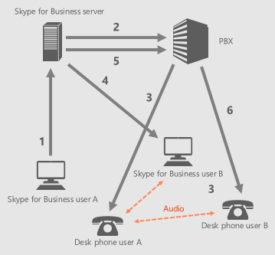
Outbound call to internal user
User A initiates a call to user B
UCWA places the initial call to self/desk phone
PBX rings the desk phone of user A
Once answered, UCWA places second call to user B
Since user B is enabled for CvW and set Simulring to their own desk phone, ms-skipRnl header is used to force another call out to user B’s desk phone
Once user B answered on Skype for Business client or desk phone, call is connected
User experience | Conversation window
Call initiated from Skype for Business client | Available
Call initiated from desk phone | Not Available

Slide 19
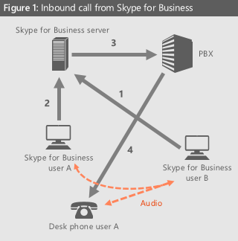
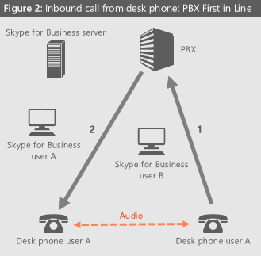
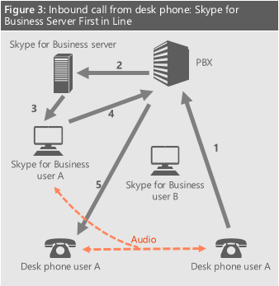
Inbound call from internal user
User B calls user A from Skype for Business client or PBX phone
PBX or Skype for Business Server receives the call (depending on who originated the call—see below)
If Skype for Business Server receives the call, user A’s endpoint is alerted. Since user A is enabled for CvW and set to simulring their own desk phone, the ms-skipRnl header is used to force another call out to user A’s desk phone
If PBX receives the call, PBX rings the desk phone of user A as shown below

Slide 20
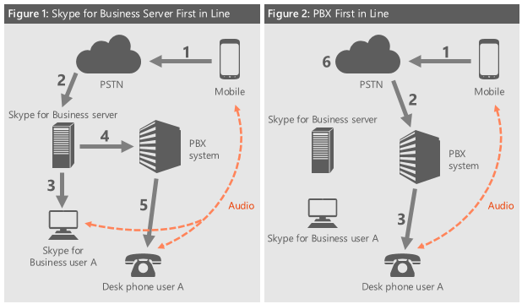
Inbound call from external user (PSTN)
PSTN user calls User A
PBX or Skype for Business Server receives the call (depending on who originated the call—see below)
If Skype for Business Server receives the call, user A’s endpoint is alerted
Since user A is enabled for CvW and set to simulring their own desk phone, the ms-skipRnl header is used to force a call out to user A’s desk phone

Slide 21
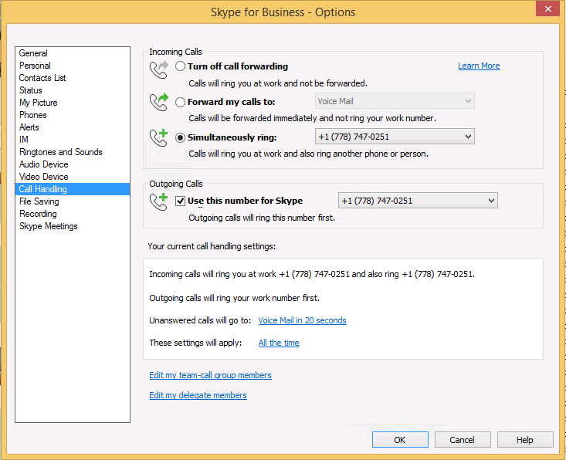
User configuration

Slide 22
Videoconference Features

Slide 23
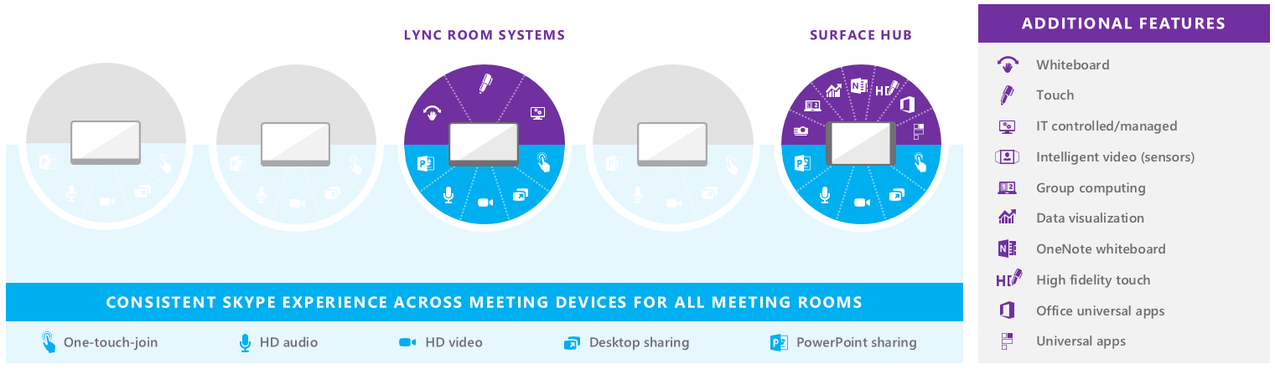
Video Devices Strategy
Enable a consistent, rich Skype collaboration experience across meeting devices
Power the partner ecosystem to serve the full spectrum of 50 million meeting rooms
Offer Surface Hub to illustrate the art of the possible and to accelerate adoption

Slide 24
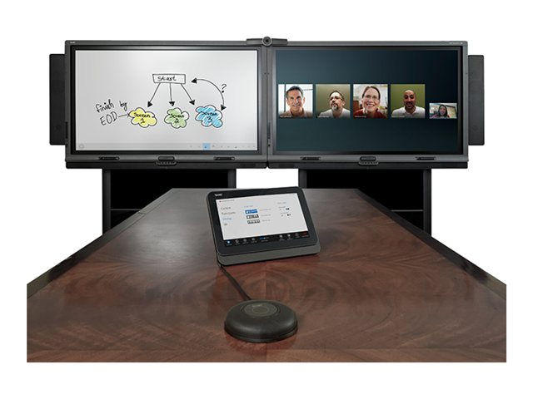
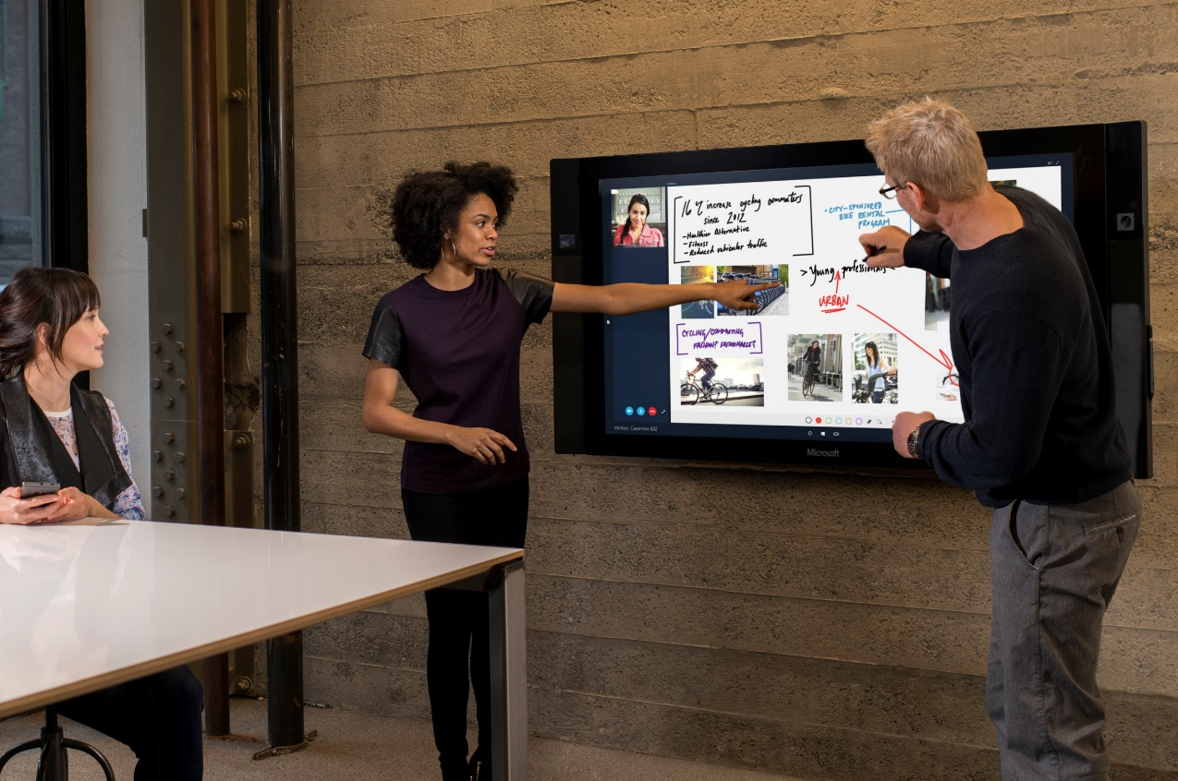
Lync Room System Vs Surface Hub

Slide 25
Video Interoperability Server (VIS)
New server role both on premises or hybrid with on premises
Aimed at legacy Video Interoperability
VIS is a software solution “built in” to Skype for Business and is scalable
Allowing existing VTCs to connect to Skype for Business, leveraging existing investments
Connectivity to conferences with audio and video as well as peer-to-peer
Simplifies interoperability and eliminates the need for third-party infrastructure
The Skype for Business meeting experience is consistent and familiar to users

Slide 26
VIS to CUCM SIP Trunk Mode
Signaling
Conference
Auto
Attendant
Media
A/V
MCU
Cisco
Unified
Call
Manager
VIS
Capabilities:
Signaling: Cisco/Tandberg VTCs support SIP, H.323
Support SDP for media negotiation
Media: Cisco/Tandberg VTCs support RTP/RTCP and the H.264 AVC codec which was standardized in RFC 6184

Slide 27
Supported Scenario – Cisco VTCs
VTCs remain registered to Cisco infrastructure
Video SIP trunk between CUCM and VIS
VTCs are Cisco endpoints and can call Skype for Business
Outbound calls from Skype for Business to CUCM not supported in this initial release
Conferencing functionality:
VTC can dial into conference via CAA
Drag-and-drop not supported
Calls from VIS to VTC are not supported
Set of VTCs that haven been tested with VIS (release TC7.0.0 or above):
Cisco C40, Cisco C60, Cisco C90
Cisco MX200, Cisco MX300
Cisco EX60, Cisco EX90
Cisco SX20

Slide 28
Hybrid Features

Slide 29
Hybrid Coexistence
On-Premises Environment
Exchange Online
Skype for Business Online
OneDrive for Business Online
Lync
Federation Edge
Shared Interoperability:
IM/P, A/V, App Sharing, OWA, UM
Microsoft Federation Gateway
Edge
Directory sync
Sign-on and authentication
Skype for Business Pool
Directory
Sync
AD FS
Integration between local IT systems and the cloud
Active
Directory
DirSync–provisioning, GAL
Federation for SSO
On-Premises
User
On-Line
User
Hybrid Interoperability

Slide 30
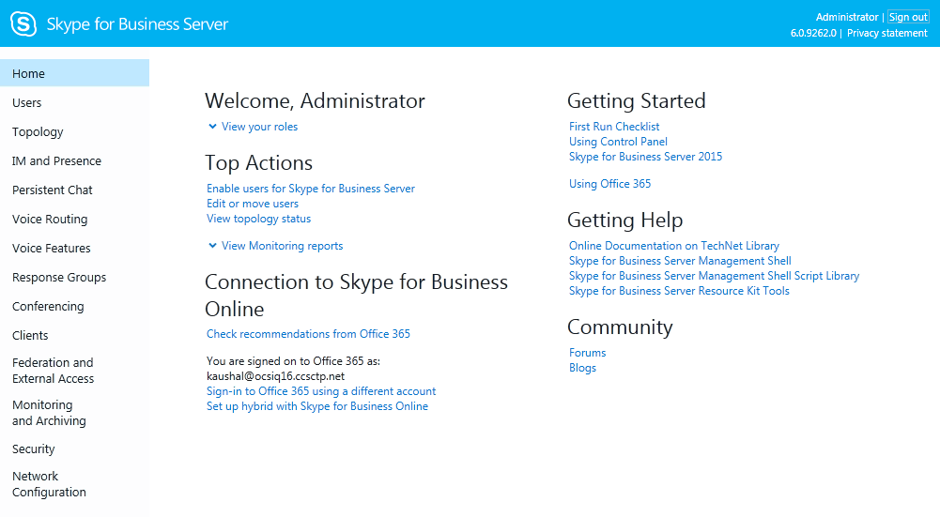
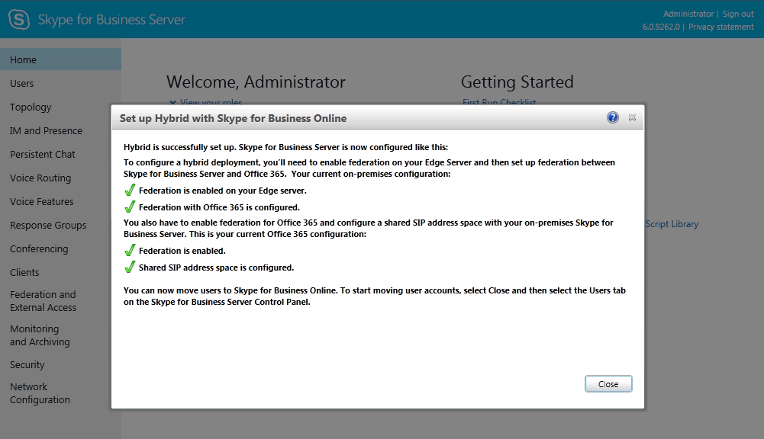
Hybrid Manageability Improvements

Slide 31
Features – Online, OnPremise, Hybrid
 | On premises user | On premises user + Hybrid features | Online user + Hybrid features | Online user
IM/Presence | Yes
Conferencing | Yes
Dial-in conferencing | Via local PBX/PSTN or New PSTN Conferencing in Office 365** |  | Audio Conferencing Provider or New PSTN Conferencing in Office 365*
Enterprise Voice | Via local PBX/PSTN |  | New PSTN Calling in Office 365*
 | Via local PBX/PSTN***
Persistent Chat | Yes |  | No
Broadcast meeting* | No | Yes
Cloud conferencing recording* | No | Yes
Video Interop Server | VIS calls possible |  |  | No
APIs | All APIs |  |  | Selected APIs
* Available post RTM
** planned feature
*** available for server today; planned feature for online user in hybrid configuration

Slide 32
Going BIG with Meetings
 | Skype for Business | Large Meeting | Broadcast
Maximum audience size | 250 | 1000 | 10,000
Presenter Camera A/V | ✓ | ✓ | ✓
PowerPoint | ✓ | ✓ | ✓
Desktop & App Sharing | ✓ |  | ✓
Attendee Camera A/V | ✓
Apps (Whiteboard, Poll, Q&A) | ✓ | ✓
PSTN Access | ✓ | ✓ | ✓
Cloud based meeting recording |  |  | ✓
Client DVR controls (ex: pause, rewind) |  |  | ✓
Personalized meeting experience |  |  | ✓
Meeting Producer role |  |  | ✓

Slide 33

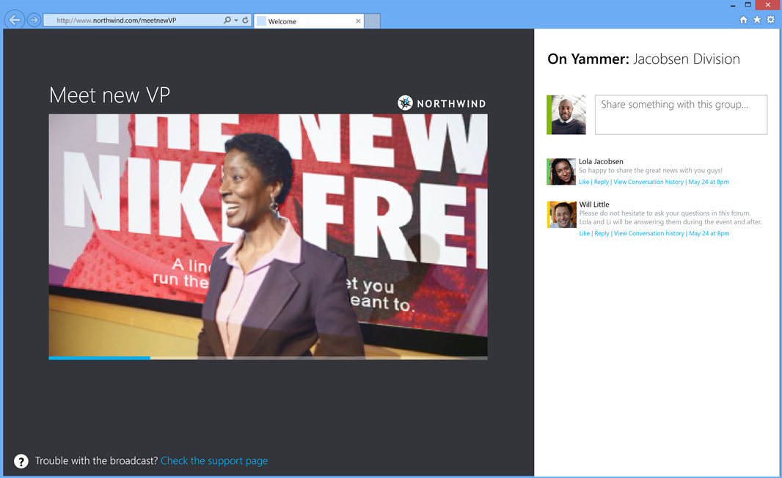
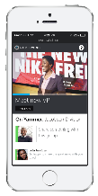

Basic Building Blocks
Producer
Skype for Business
Online ‘Inner Meeting’
Azure Media Services
HD Video
Local / Remote Speaker
Studio or Auditorium A/V
Content Delivery Network
Federated presenter accounts
Web Attendee Client
Mobile Clients

Slide 34
Scheduling a Broadcast
Organizers can…
Discover broadcast options when scheduling a large meeting in Outlook
Create and manage broadcast events in the Skype for Business broadcast portal
Pre-meeting
Manage access settings, attendees list and event team roster
Customize the event including theme, curtains and branding imagery
Post-meeting
Download or publish meeting recordings
Access meeting attendee reports, count, device mix, other telemetry

Slide 35
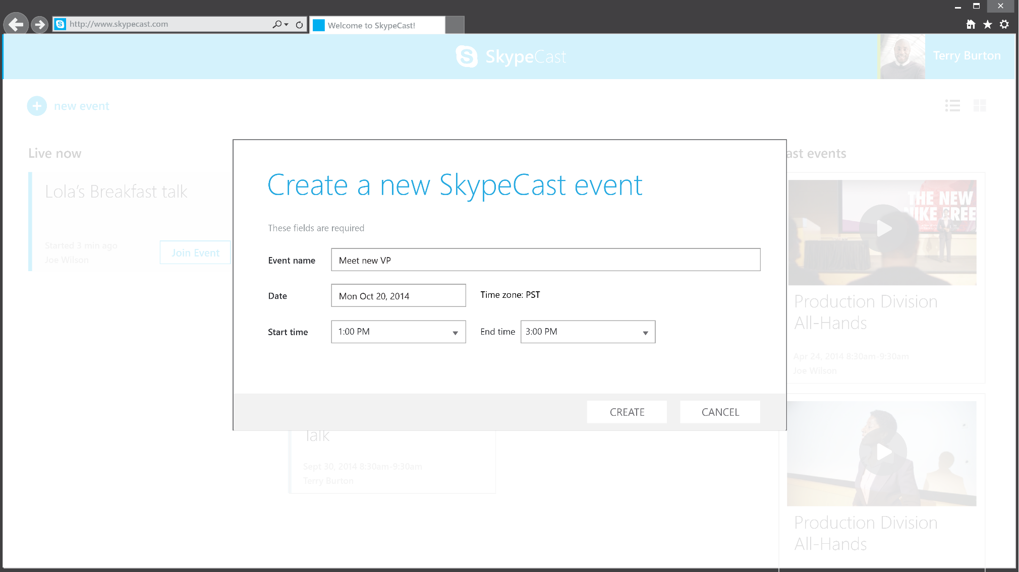
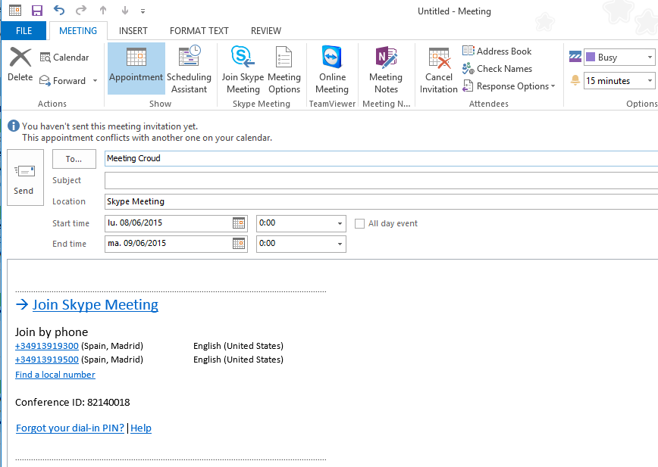
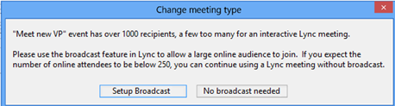
Scheduling a Broadcast

Slide 36
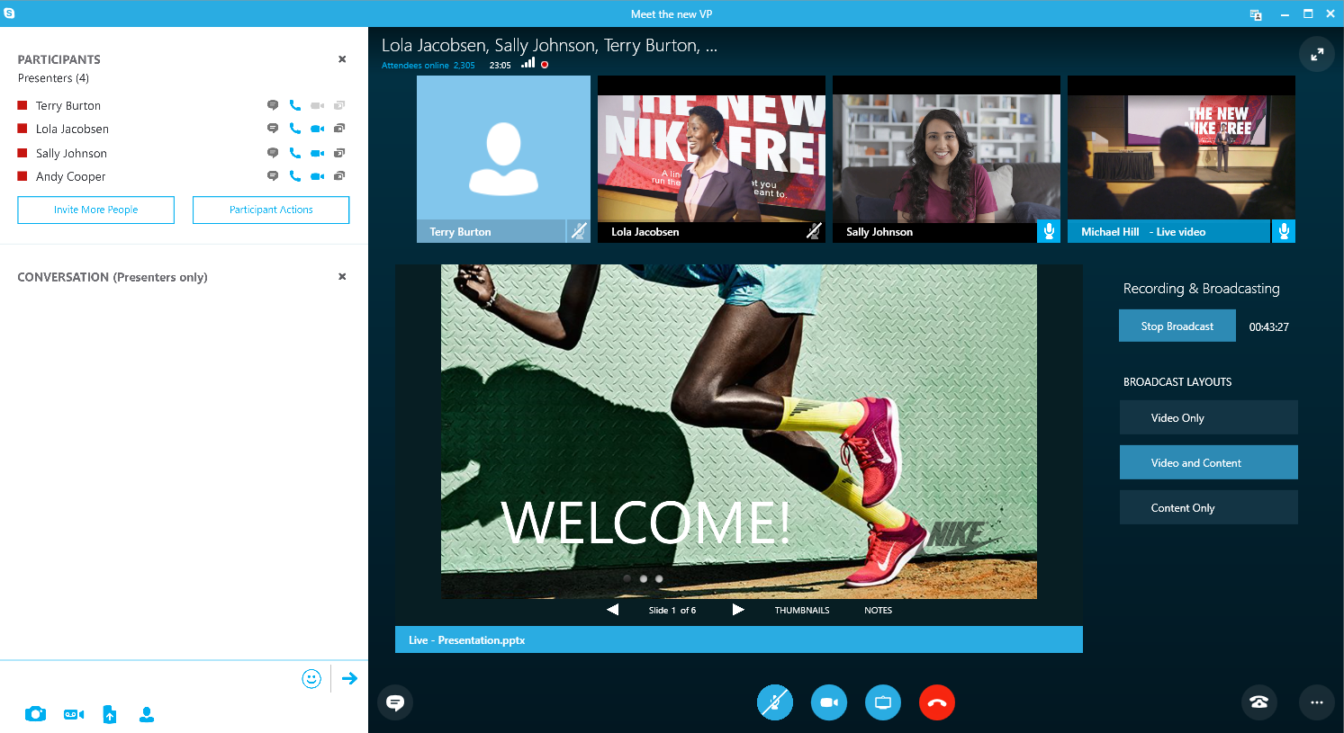
Produce using Skype for Business

Slide 37
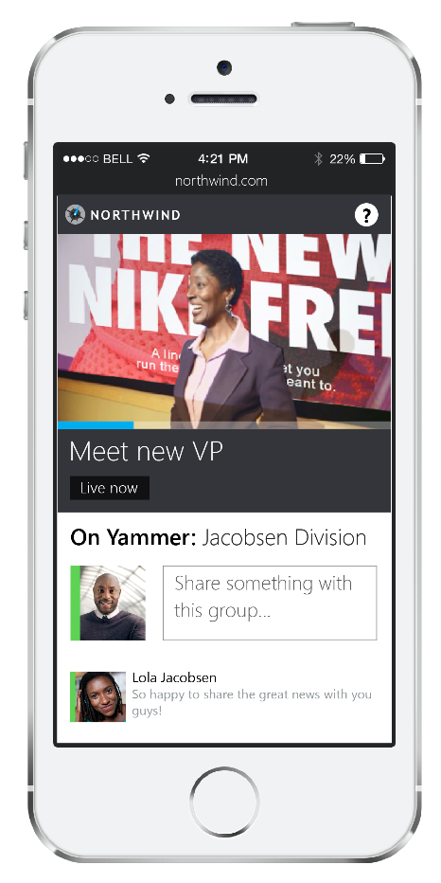
Attendee Experience

Slide 38
Upgrade from Lync

Slide 39
Upgrade Path
Original Topology | New Topology | In-Place Upgrade Supported ?
Lync 2013 | Skype For Business Server 2015 + Lync 2013 | Yes. In-Place upgrade support from 2013 -> Skype For Business Server
Lync 2010 | Skype For Business Server 2015 + Lync 2010 | No. Upgrade from 2010 -> Skype For Business Server is the same process as 2010 -> 2013
Lync 2010 + Lync 2013 | Skype For Business Server 2015 + Lync 2013 | Mandatory migration from 2010 to 2013 before deploying Skype For Business Server 2015. Then In-Place upgrade from 2013 to Skype For Business Server

Slide 40
Upgrade Prerequisites
Install latest cumulative update to Lync 2013 Topology (minimum CU5)
PowerShell version (6.2.9200.0) or later
At least SQL Server 2012 SP1 installed
Windows Server needs one of the following update:
KB2533623 - Windows Server 2008 R2
KB2858668 - Windows Server 2012
KB2982006 – Windows Server 2012 R2

Slide 41
In-Place Upgrade from Lync 2013 to Skype For Business 2015
1- Move Pool1 Users to Pool2
Pool1 (Lync 2013 CU5)
Pool2 (Lync 2013 CU5)
2- Upgrade Pool1 Servers to Skype for Business
3- Move Back Pool1 Users
4- Move Pool2 Users to Pool1
Pool1 (Skype for Business 2015)
Pool2 (Lync 2013 CU5)
5- Upgrade Pool2 Servers to Skype for Business
6- Move Back Pool2 Users
Pool1 (Skype for Business 2015)
Pool2 (Skype for Business 2015)

Slide 42
In-Place Upgrade Recommendations
No In-Place Upgrade with Disaster Recovery (Pool-Failover)
Don’t use the Invoke-CsPoolFailover cmdlets to failover the pool!
Don’t start services in Mixed Mode (half upgraded pool)
Don’t Un-Pair the Pools before Upgrade
Ensure minimal time when the Pools are paired with different versions

Slide 43
Offline Mode Upgrade from Lync 2013 to Skype For Business 2015
1- Send Maintenance Notice to Pool1 Users
Pool1 (Lync 2013 CU5)
Pool2 (Lync 2013 CU5)
2- Upgrade Pool1 Servers to Skype for Business
3- Ensure features are working in Pool1
4- Send Notice to Pool1 Users that services are up
and running
Pool1 (Skype for Business 2015)
Pool2 (Lync 2013 CU5)
5- Send Maintenance Notice to Pool2 Users
6- Upgrade Pool1 Servers to Skype for Business
7- Ensure features are working in Pool2
8- Send Notice to Pool1 Users that services are up
and running
Pool1 (Skype for Business 2015)
Pool2 (Skype for Business 2015)

